Slide 1
Know Canada
Notes:
Team Name -

Slide 2
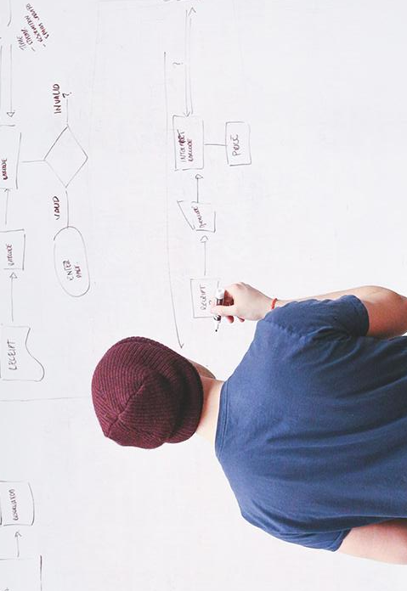
“Data scientists are involved with gathering data, massaging it into a tractable form, making it tell its story, and presenting that story to others.”
– Mike Loukides,
Editor, O’Reilly Media
Notes:
Team Introductions

Slide 3
Canadians & Data Literacy
Why Care?
Notes:
The Problem we are trying to solve
How does your game or gamified procedure benefit and engage with Canadians?
General public doesn’t know what we do/have. Limited visibility
If they don’t know why it is important then they are less likely to respond (decreased response rates across the department)

Slide 4
11,132,923
Website visits to statcan.gc.ca
Notes:
Number of something StatsCan produces of tables/databases/whatever
Businesses etc not necessarily general publicéaverage canadians

Slide 5
68,620 publications
157 surveys
5,036 tables
Available to Canadians
In collection currently
To analyze

Slide 6
User Stories
Why Care?
Notes:
The Problem we are trying to solve
How does your game or gamified procedure benefit and engage with Canadians?

Slide 7

Janice & Dean
Family in Halifax, NS
Notes:
- Use StatCan data for family fun and educating children

Slide 8

Harpreet
Teacher in Toronto, ON
Notes:
- Use Statcan Data as teaching tool to help youth understand the important of a national statistics agency and the data produced.

Slide 9

Janly
Dutch Farmer
Notes:
- Use StatCan data as a learning tool on airline in order to familiarize self with Canadian statistics.

Slide 10
SOLUTION
Notes:
What is a user’s typical experience with this process? Why should they care if you gamify it?
• How are the proposed games or gamified procedures innovative and different from the status quo?
• What is the value proposition?
Direct interaction of the public with data that StatsCan has produced.
Increased positive public perception, brand relevance
New way of disseminating statistical information and data
Engaging a new cohort/segment/audience

Slide 11
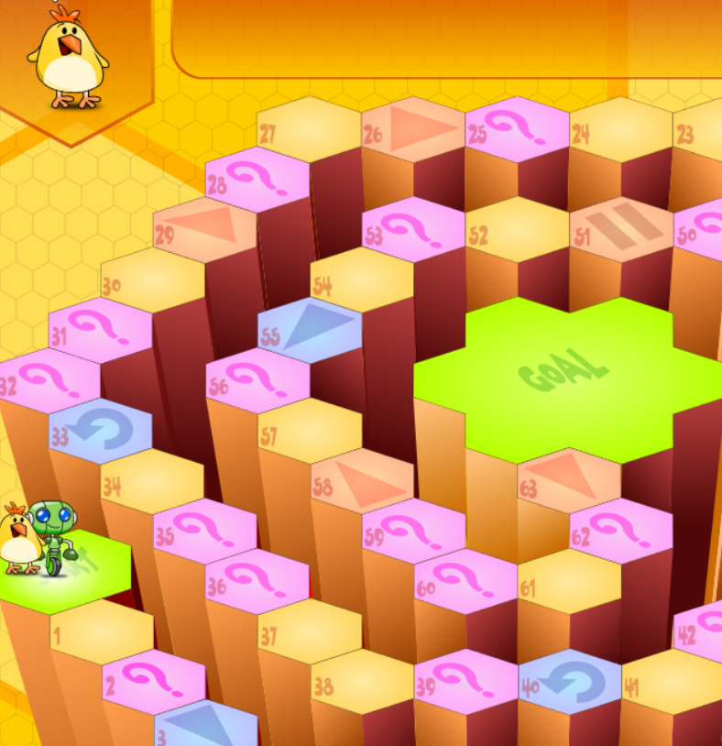
Know Canada Mockup
Notes:
Brief explanation of what done
Used github javascript project to build our mockup
Initially survey groups submit their own questions
End goal Algorithm or even AI to generate questions and get answers from the NDM tables – by bringing in the data, for example via the StatCan API, and automatically analyzing it to determine eg highest number of imports of a given commodity and use that to determine the answer, and can also find incorrect answers from the same data
Can also use algorithm, machine learning to tailor questions based on user responses
Tailor questions based on user input of location, age, etc.
Potential collaboration with other government agencies for Qs and data
Will collect demographic information and potential to collect other information during gameplay (i.e. what categories people don’t know about)
-ex. No one knows about trade – build a bigger public presence with infographs and media outreach when learning this.

Slide 12
Troubleshooting
Identified Risks

Slide 13
Risk – IT Security
Injection Attack
Notes:
-if collecting data then the response database that collects user response data needs to be adequately secure to statcan standards

Slide 14
Risk – IT Security
Risk:
Low
Injection Attack
Notes:
-if collecting data then the response database that collects user response data needs to be adequately secure to statcan standards

Slide 15
Risk – IT Security
Risk:
Low
Injection Attack
Potential:
High
Notes:
-if collecting data then the response database that collects user response data needs to be adequately secure to statcan standards

Slide 16
Risk – IT Security
Risk:
Low
Injection Attack
Sanitize User Inputs
Potential:
High
Notes:
-if collecting data then the response database that collects user response data needs to be adequately secure to statcan standards

Slide 17
Risk – Public Perception
Intrusive/ Messaging
Notes:
-if collecting data then the response database that collects user response data needs to be adequately secure to statcan standards

Slide 18
Risk – Public Perception
Risk:
Medium
Intrusive/ Messaging
Notes:
-if collecting data then the response database that collects user response data needs to be adequately secure to statcan standards

Slide 19
Risk – Public Perception
Risk:
Medium
Intrusive/ Messaging
Potential:
Medium
Notes:
-if collecting data then the response database that collects user response data needs to be adequately secure to statcan standards

Slide 20
Risk – Public Perception
Risk:
Medium
Intrusive/ Messaging
Explict Terms of Use
Potential:
Medium
Notes:
-if collecting data then the response database that collects user response data needs to be adequately secure to statcan standards

Slide 21
Risk – System Failure
User Overload
Notes:
Aka game crashes

Slide 22
Risk – IT Security
Risk:
Medium
User Overload
Notes:
-if collecting data then the response database that collects user response data needs to be adequately secure to statcan standards

Slide 23
Risk – IT Security
Risk:
Medium
Injection Attack
Potential:
Low
Notes:
-if collecting data then the response database that collects user response data needs to be adequately secure to statcan standards

Slide 24
Risk – IT Security
Risk:
Medium
Injection Attack
Cloud Based Game
Potential:
Low
Notes:
-if collecting data then the response database that collects user response data needs to be adequately secure to statcan standards

Slide 25
Value Proposition to StatsCan
Data Literacy
Response Analysis
Modular
Interdepartmental
Cost Recovery
Notes:
Testing a different approach

Slide 26

Value Proposition to StatsCan
Data Literacy
Response Analysis
Modular
Interdepartmental
Cost Recovery
Notes:
Testing a different approach

Slide 27
Value Proposition to StatsCan
Data Literacy
Response Analysis
Modular
Interdepartmental
Cost Recovery
Demographic Information
Categorical Analysis
Notes:
Testing a different approach

Slide 28

Value Proposition to StatsCan
Data Literacy
Response Analysis
Modular
Interdepartmental
Cost Recovery
Notes:
Testing a different approach

Slide 29
Value Proposition to StatsCan
Data Literacy
Response Analysis
Modular
Interdepartmental
Cost Recovery
Notes:
Testing a different approach

Slide 30
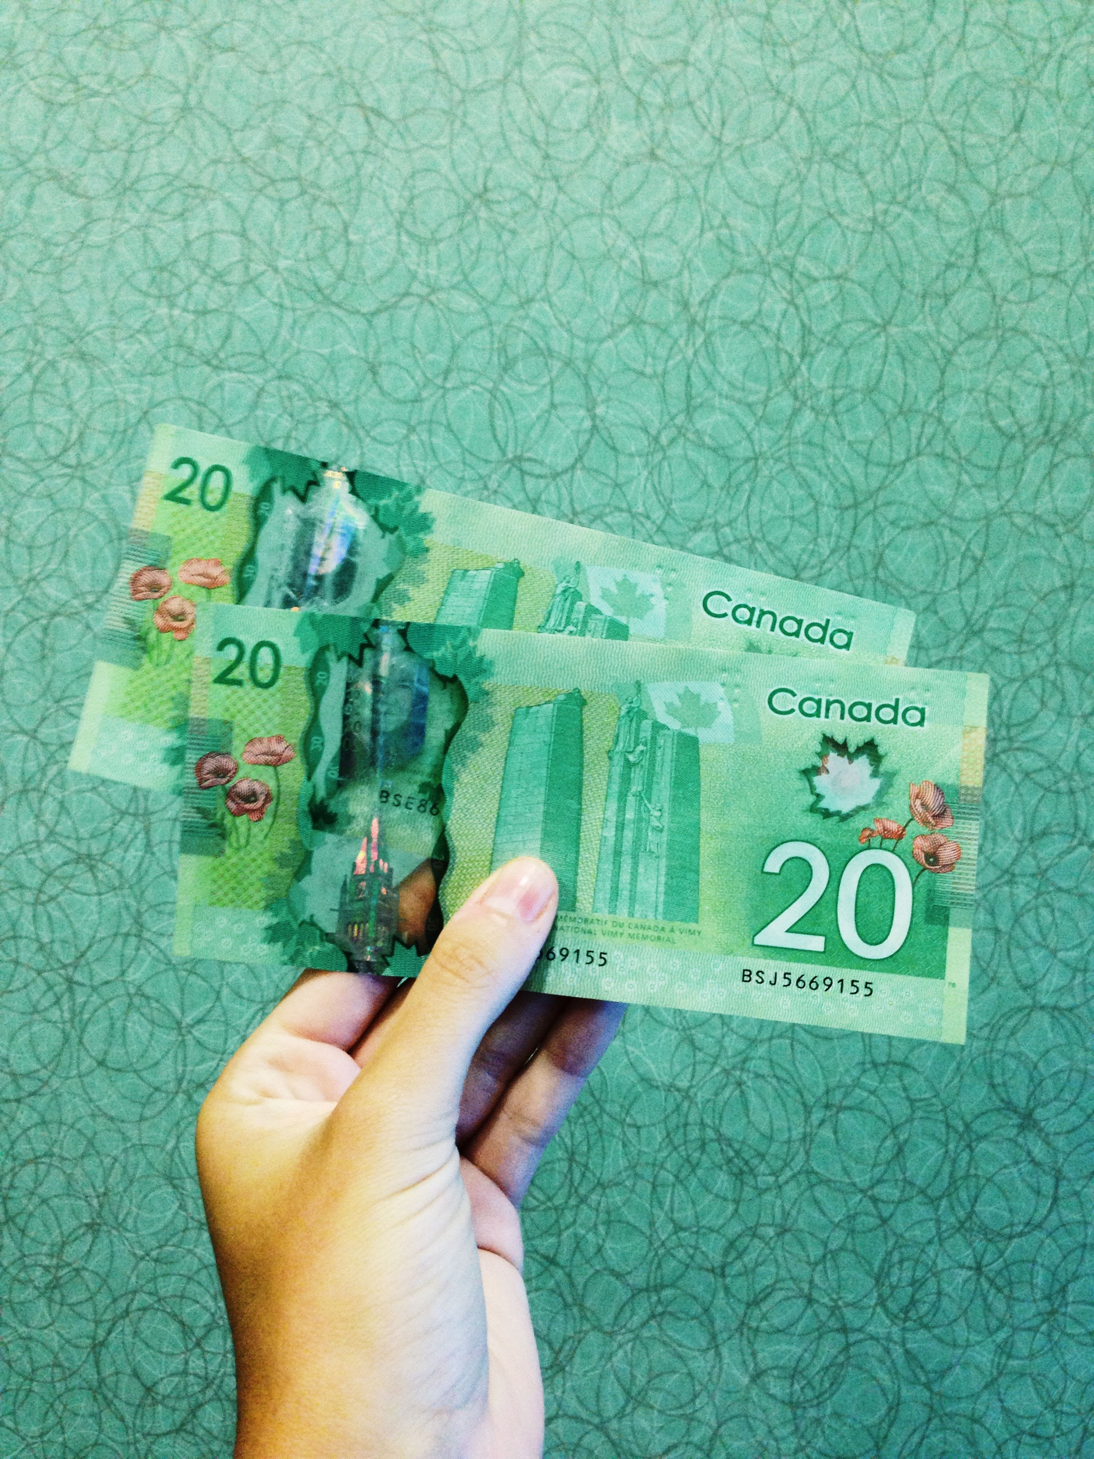
Value Proposition to StatsCan
Data Literacy
Response Analysis
Modular
Interdepartmental
Cost Recovery
Notes:
Testing a different approach

Slide 31
THANKS!
Any questions?

Slide 32
Platform Information
Yellow
Is the color of gold, butter and ripe lemons. In the spectrum of visible light, yellow is found between green and orange.
Blue
Is the colour of the clear sky and the deep sea. It is located between violet and green on the optical spectrum.
Red
Is the color of blood, and because of this it has historically been associated with sacrifice, danger and courage.

Slide 34
“A data scientist is someone who can obtain, scrub, explore, model, and interpret data, blending hacking, statistics, and machine learning. Data scientists not only are adept at working with data, but appreciate data itself as a first-class product.”
– Hillary Mason, Founder,
Fast Forward Labs

Slide 35
“Think analytically, rigorously, and systematically about a business problem and come up with a solution that leverages the available data.”
– Michael O’Connell,
Chief Analytics Officer, TIBCO

Slide 36
“The goal is to turn data into information and information into insight.”
– Carly Fiorina, Former Chief Executive Officer, Hewlett Packard

Slide 37
Value Proposition to StatsCan
Data Literacy
Response Analysis
Modular
Interdepartmental
Cost Recovery

Slide 38
Value Proposition to StatsCan
Data Literacy
Response Analysis
Modular
Interdepartmental
Cost Recovery

Slide 39
Value Proposition to StatsCan
Data Literacy
Response Analysis
Modular
Interdepartmental
Cost Recovery

Slide 40
Value Proposition to StatsCan
Data Literacy
Response Analysis
Modular
Interdepartmental
Cost Recovery

Slide 41
Value Proposition to StatsCan
Data Literacy
Response Analysis
Modular
Interdepartmental
Cost Recovery

Slide 42
Value Proposition to StatsCan
Data Literacy
Response Analysis
Modular
Interdepartmental
Cost Recovery

Slide 43

Value Proposition to StatsCan
Data Literacy
Response Analysis
Modular
Interdepartmental
Cost Recovery
Notes:
Testing a different approach

Slide 44
Risk – Public Perception
Intrusive questions.
Unclear messaging on data collection
Potential: Medium
Risk: Medium
Be explicit in the Terms of Use
Notes:
-if collecting data then the response database that collects user response data needs to be adequately secure to statcan standards

Slide 45
Risk – Game Crashes
So many users the game crashes
Potential: Low
Risk: Medium
Cloud-Based Game
Notes:
-if collecting data then the response database that collects user response data needs to be adequately secure to statcan standards

Slide 46
Data Integration Pathway
FIRST
SECOND
LAST

Slide 47
Risk – IT Security
Injection attacks.
Potential: High
Risk: Low
Sanitize user inputs

Slide 48
Risk – IT Security
Risk:
Low
Injection Attack
Sanitize User Inputs
Potential:
High

